Slide 1
Computer Vision and Deep Learning
Lecture 7

Slide 2
Last time
CNN architectures
Alexnet
VGG
GoogLe Net
ResNet
Mobilenets

Slide 3
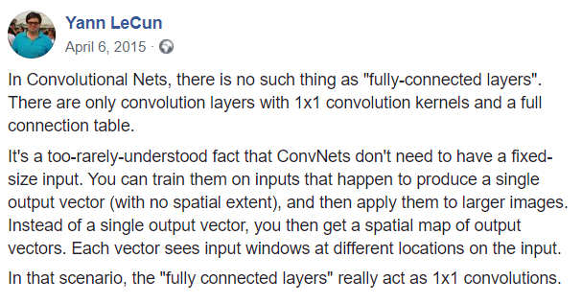

Slide 4
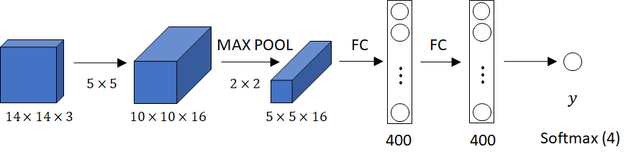
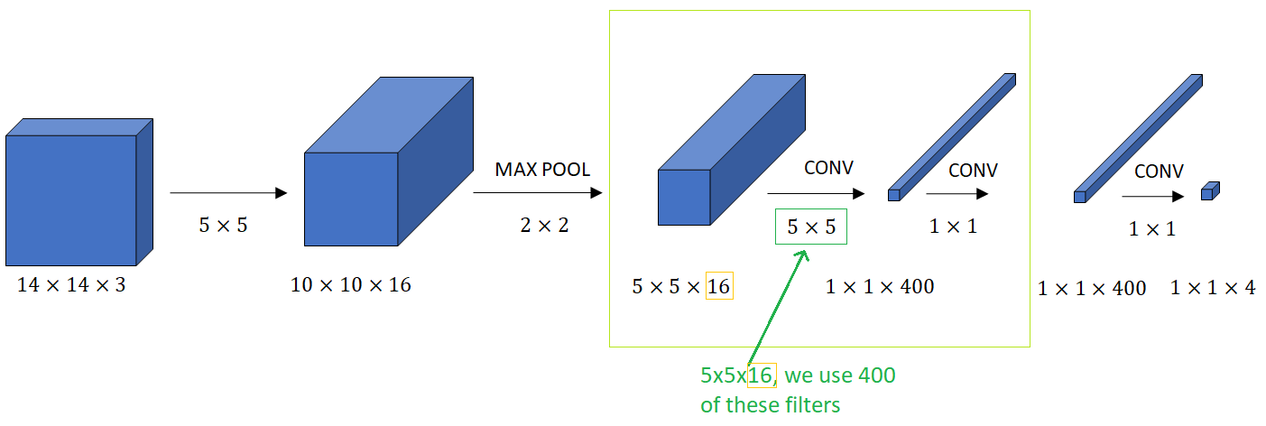
Image credit: Andrew Ng

Slide 5
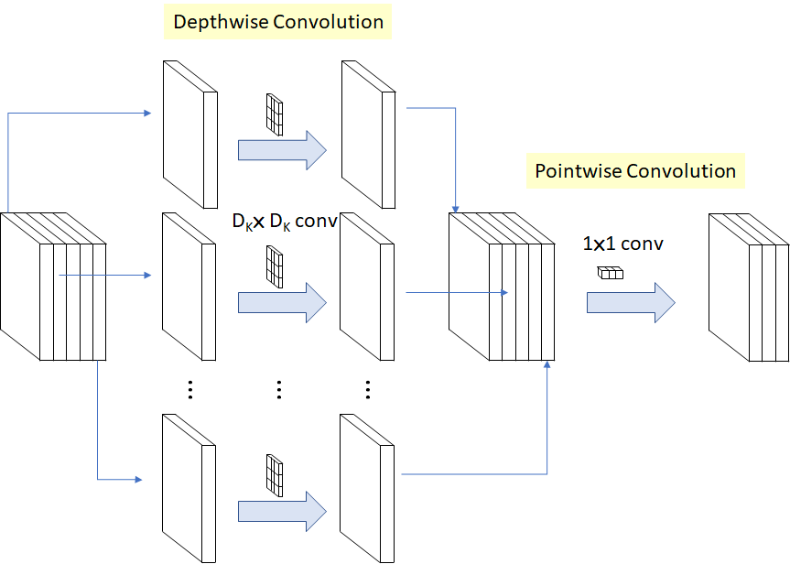

Depth-wise separable convolutions
M: Number of input channels,
N: Number of output channels,
DK: Kernel size
DF: Feature map size
Operation cost:
vs.
Depthwise convolution
Classical convolution

Slide 6
Depth-wise separable convolutions

Slide 7
Depth-wise separable convolutions

Slide 8
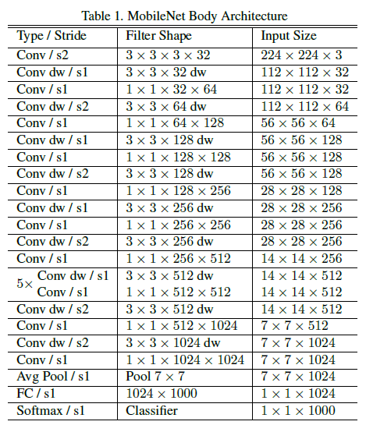
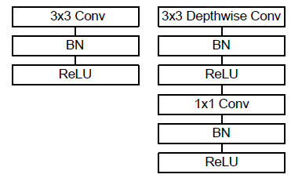
Mobilenets

Slide 9
Other architectures

Slide 10
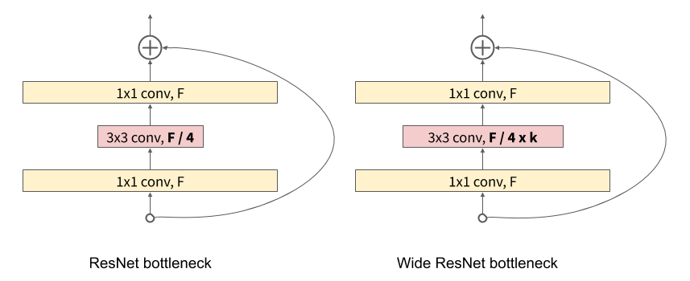
Wide RESNET
Use wider residual blocks (larger number of filters)
50 layer wide resnet is better than 101 layer classical resnet
https://arxiv.org/pdf/1605.07146.pdf

Slide 11
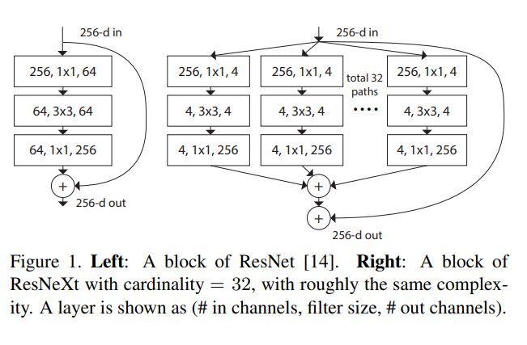
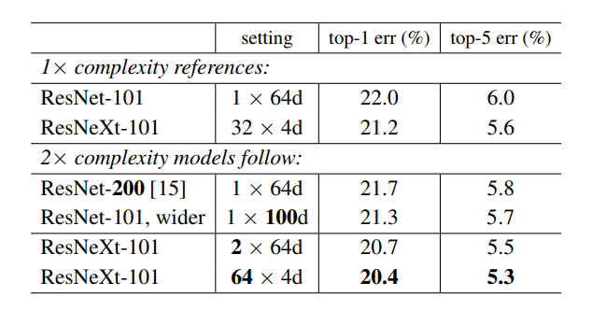
ResNext
Again increase the width of the networks, but this time through parallel branches in a block
https://arxiv.org/pdf/1611.05431.pdf

Slide 12
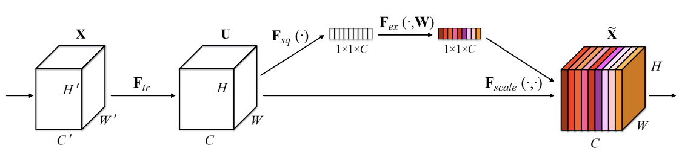
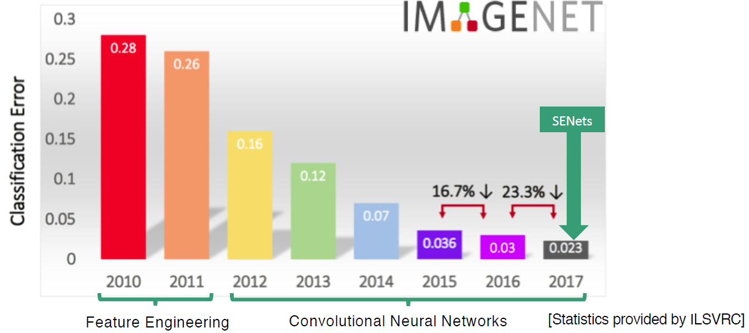
SENet
ImageNet 2017 winner
2.3% top-5 accuracy
Compute weight for each feature map:
Global average pooling
2FC layers
Squeeze-and-Excitation Networks, 2018: https://arxiv.org/pdf/1709.01507.pdf

Slide 13

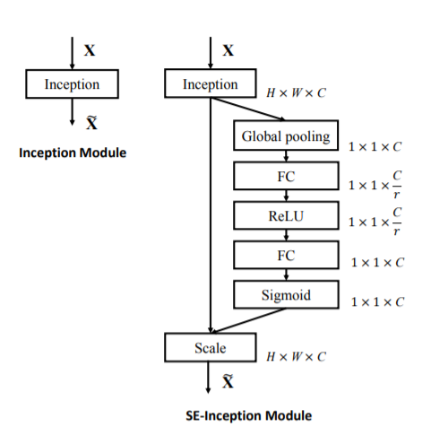

SENet
Squeeze (Global Information Embedding) squeeze global spatial information into a channel descriptor
Excitation (Adaptive Recalibration)
capture channel-wise dependencies
dynamics conditioned on the input

Slide 14
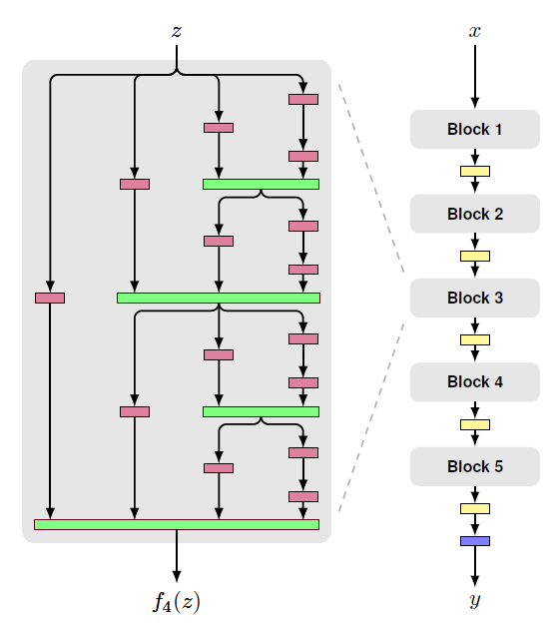
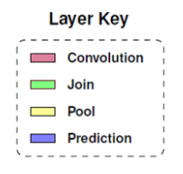
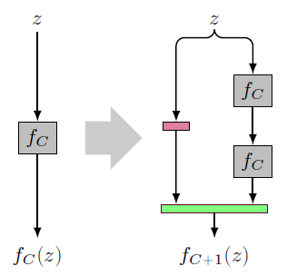
Fractal Nets
non-residual-network approach
neural network macro-architecture based on self-similarity
both shallow and deep paths to output
the key may be the ability to transition, during training, from effectively shallow to deep
FractalNet: Ultra-Deep Neural Networks without Residuals, 2017

Slide 15
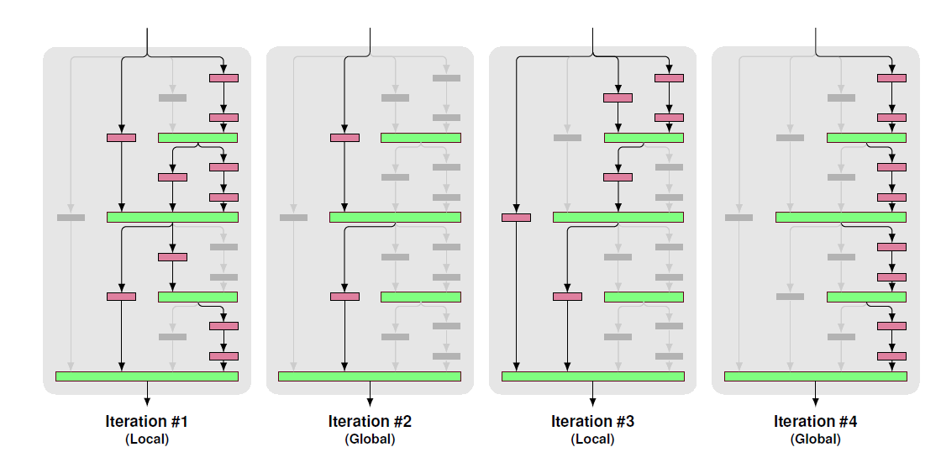
Fractal nets
Drop path - prevents co-adaptation of parallel paths by randomly dropping operands of the join layers
Global: a single path is selected for the entire network
Local: drops each input with fixed probability

Slide 16
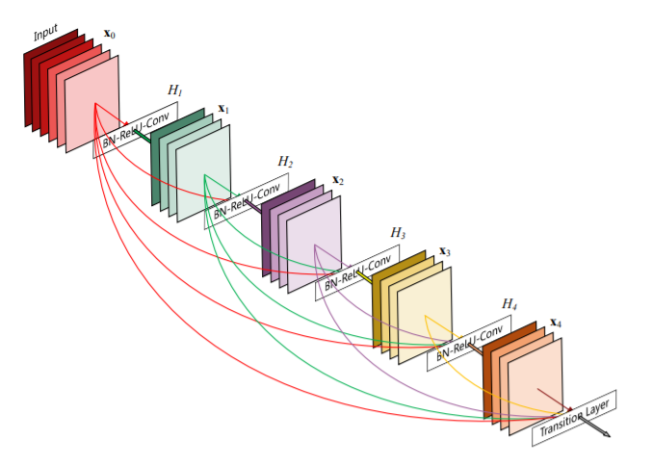
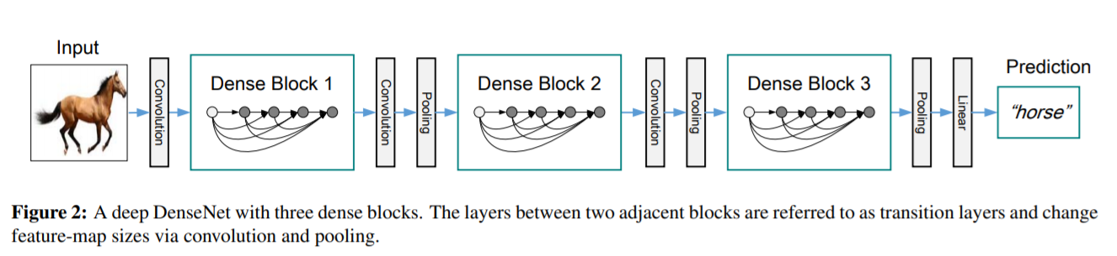
Densely connected networks
Dense block: each layer is connected to every other layer in feed-forward fashion
- strengthens feature propagation,
- encourages feature reuse
- helps with the vanishing gradients problem
Densely Connected Convolutional Networks, 2017

Slide 17
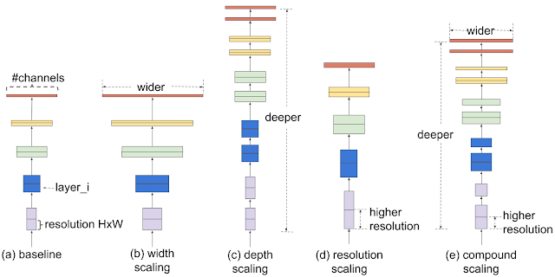
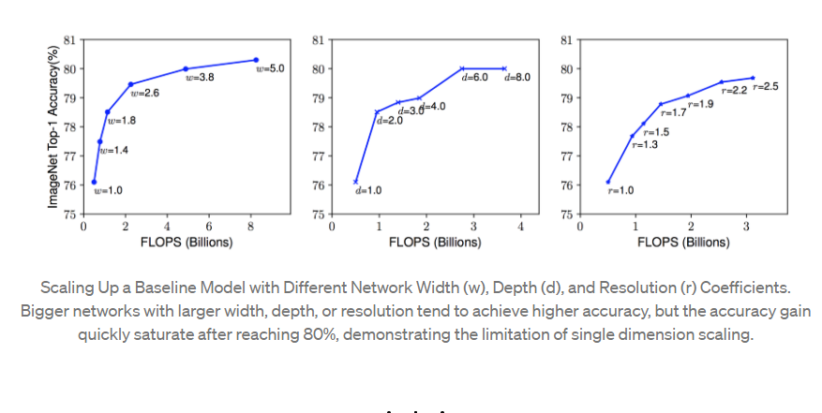
Efficient nets

Slide 18
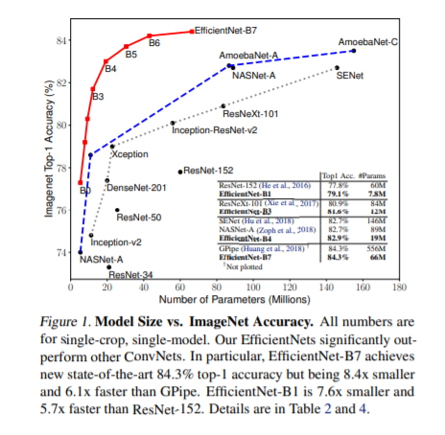
Efficient nets
carefully balancing network depth, width, and resolution can lead to better performance
design a new baseline network and scale it up to obtain a family of models, called EfficientNets

Slide 19
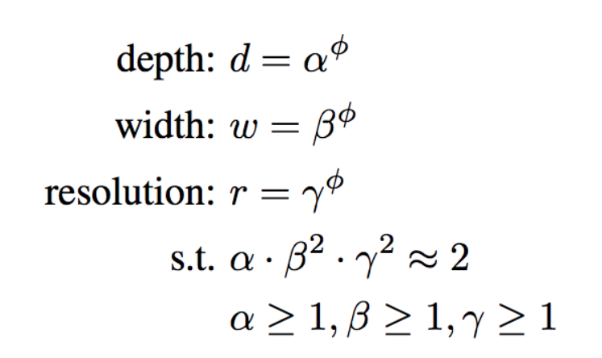
Efficient nets
α · β ² · γ ² ≈ 2 such that for any new φ, the total FLOPS will approximately increase by 2^{φ}
Combined scaling:

Slide 20
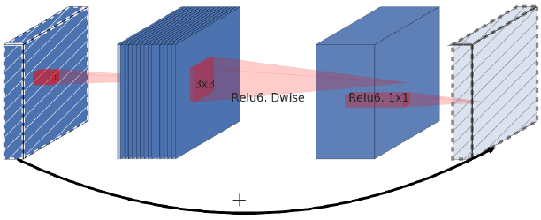
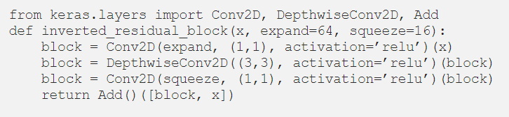
MBConv block

Slide 21
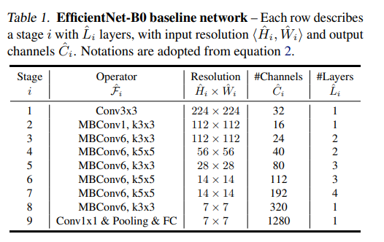
Random grid search to determine α = 1.2, β = 1.1, γ = 1.1
Fix α, β, γ as constants and scale up baseline network with different φ (EfficientNet-B1 to B7)

Slide 22
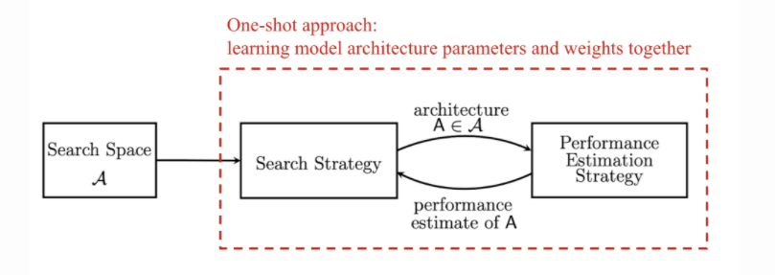
Neural network architectural search
Search space: define a set of operations and how they can be connected.
Search strategy: samples a population of network architecture candidates: child model performance metrics as rewards and optimizes to generate high-performance architecture candidates.
Performance estimation strategy: measure, estimate, or predict the performance of the proposed child models in order to obtain feedback for the search algorithm to learn
https://lilianweng.github.io/lil-log/2020/08/06/neural-architecture-search.html

Slide 23
Summary – CNN architectures
Networks are getting more and more deep
The trend is to not use fully connected layers anymore
Pre-trained models on large datasets are available
ResNet and SENet currently good defaults to use
Convolutional networks design is still a flourishing research area
aspects of network architectures are continuously investigated and improved

Slide 24
Summary – CNN architectures
Alexnet
VGG
Inception
ResNet
SeNet
Fractal nets
Densely connected nets
Mobile nets
Efficient nets

Slide 25
Transfer learning

Slide 26
Transfer learning
Have some dataset for a problem you want to solve but it has < ~1M images?
Find a very large dataset that has similar data, train a big ConvNet there
Transfer learn to your dataset
It’s the norm, not the exception!

Slide 27

Transfer learning

Slide 28
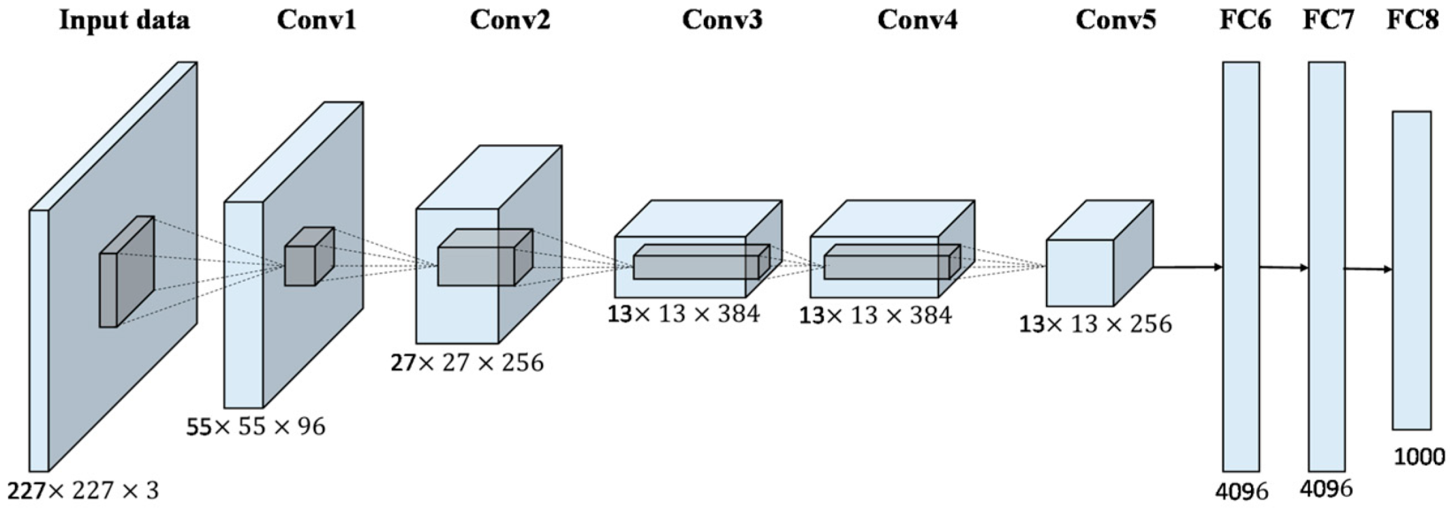
Transfer learning – small database
Train on a similar large dataset: ImageNet, COCO etc.
“freeze” these layers
Change the last dense layer to C classes, reinitialize and train it

Slide 29
Transfer learning – larger database
Train on a similar large dataset: ImageNet, COCO etc.
“freeze” these layers
Train these layers
Use a lower learning rate when finetuning! 1/10 of the original learning rate is a good starting point

Slide 30
Transfer learning
More generic features
More specific features

Slide 31
Transfer learning
 | Similar large dataset | Different large dataset
Few training data | Change and train the last layer | ☹ linear classifier from different layers in the net ?
Quite a lot of training data | Fine-tune a few layers | Fine-tune a larger number of layers

Slide 32

Transfer learning
TensorFlow: https://github.com/tensorflow/models
Keras: https://keras.io/api/applications/
PyTorch: https://github.com/pytorch/vision
https://modelzoo.co/

Slide 33
Multi-task learning
Case study

Slide 34
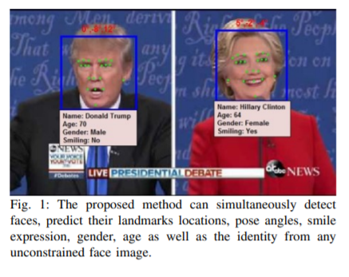
An All-In-One Convolutional Neural Network for Face Analysis (2017)
https://arxiv.org/pdf/1611.00851.pdf
Key ideas that we should take from this paper:
End to end deep learning
Multitask learning
Designing new loss functions

Slide 35
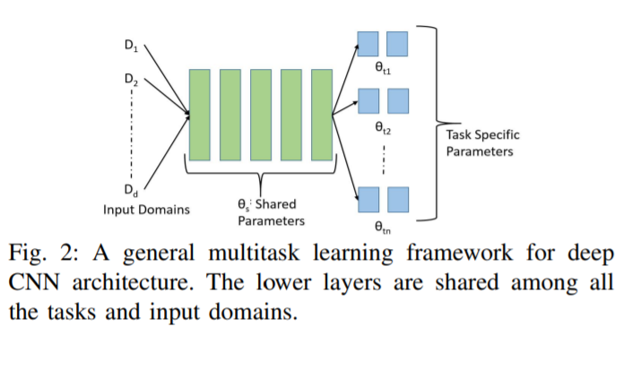
Multi-task learning
When?
Training on a set of tasks that could benefit from having shared lower-level features
Amount of data you have for each task is quite similar
Can train a big enough network to do well on all tasks
https://www.youtube.com/watch?v=UdXfsAr4Gjw

Slide 36
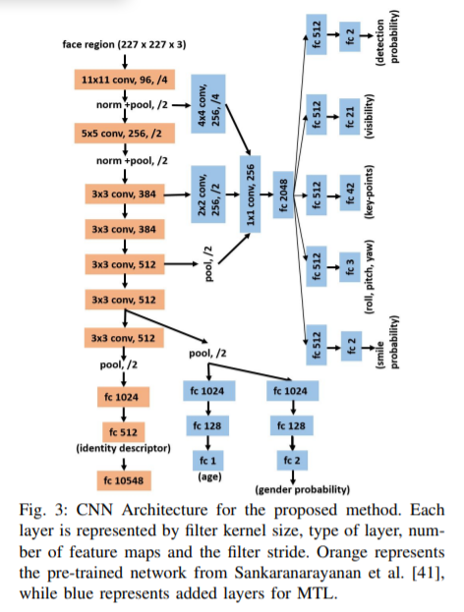



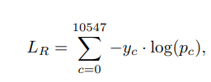
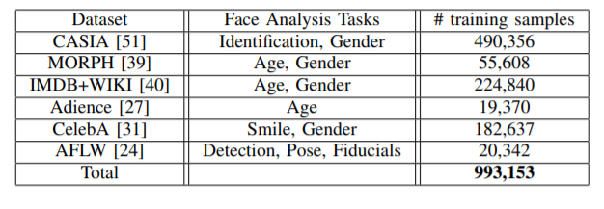
An All-In-One Convolutional Neural Network for Face Analysis (2017)

Slide 37
Multi-task learning
https://www.youtube.com/watch?v=UdXfsAr4Gjw

Slide 38
Face recognition
Case study

Slide 39
Face recognition – case study
Face verification: validating a claimed identity based on the image of a face, and either accepting or rejecting the identity claim (one-to-one matching)
Face recognition: is to identify a person based on the image of a face: the face image has to be compared with all the registered persons (one-to-many matching)
One shot learning

Slide 40
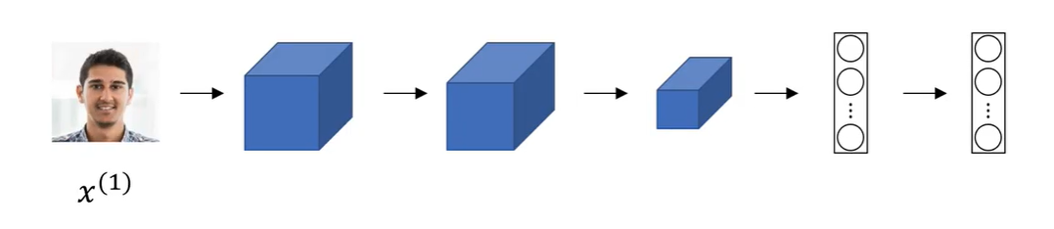
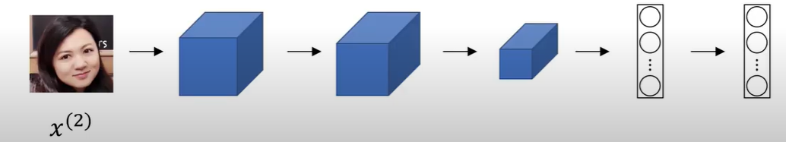
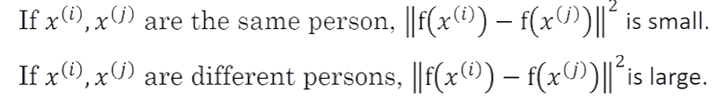
Siamese networks
Two or more inputs are encoded and the output features are compared
Example credit: Andrew Ng, deeplearning.ai, Convolutional Neural Networks

Slide 41
def build_siamese_model(inputShape, embeddingDim=48):
# specify the inputs for the feature extractor network
inputs = Input(inputShape)
# define the first set of CONV => RELU => POOL => DROPOUT layers
x = Conv2D(64, (2, 2), padding="same", activation="relu")(inputs)
x = MaxPooling2D(pool_size=(2, 2))(x)
x = Dropout(0.3)(x)
# second set of CONV => RELU => POOL => DROPOUT layers
x = Conv2D(64, (2, 2), padding="same", activation="relu")(x)
x = MaxPooling2D(pool_size=2)(x)
x = Dropout(0.3)(x)
# prepare the final outputs
pooledOutput = GlobalAveragePooling2D()(x)
outputs = Dense(embeddingDim)(pooledOutput)
# build the model
model = Model(inputs, outputs)
# return the model to the calling function
return model
https://www.pyimagesearch.com/2020/11/30/siamese-networks-with-keras-tensorflow-and-deep-learning/

Slide 42
imgA = Input(shape=config.IMG_SHAPE)
imgB = Input(shape=config.IMG_SHAPE)
featureExtractor = build_siamese_model(config.IMG_SHAPE)
featsA = featureExtractor(imgA)
featsB = featureExtractor(imgB)
distance = Lambda(utils.euclidean_distance)([featsA, featsB])
outputs = Dense(1, activation="sigmoid")(distance)
model = Model(inputs=[imgA, imgB], outputs=outputs)
model.compile(loss="binary_crossentropy", optimizer="adam",
metrics=["accuracy"])
# train the model
print("[INFO] training model...")
history = model.fit(
[pairTrain[:, 0], pairTrain[:, 1]], labelTrain[:],
validation_data=([pairTest[:, 0], pairTest[:, 1]], labelTest[:]),
batch_size=config.BATCH_SIZE,
epochs=config.EPOCHS)
https://www.pyimagesearch.com/2020/11/30/siamese-networks-with-keras-tensorflow-and-deep-learning/

Slide 43
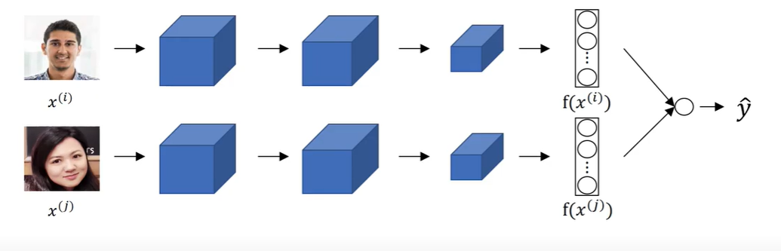
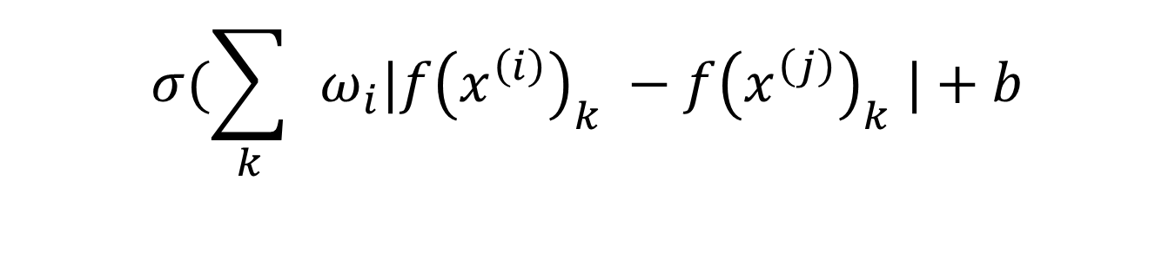
Face verification as a binary classification problem
$$σ(\sum_{k}{ }ω_{i}|f{\left(x^{\left(i\right)}\right)}_{k} −f{\left(x^{\left(j\right)}\right)}_{k} |+b$$
Example credit: Andrew Ng, deeplearning.ai, Convolutional Neural Networks

